Slide 1
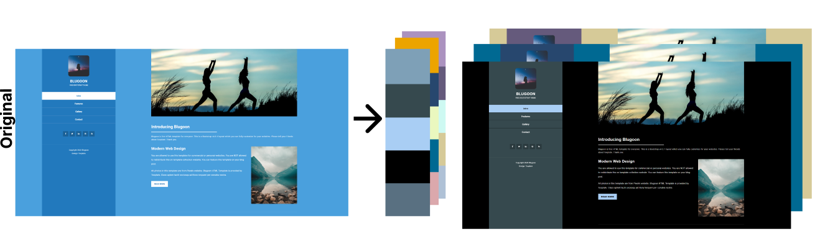
Website Color Palette Optimization Utilizing Graph-Based Visual Salience
Goal: Create an easy way to output color assignations for a given website and palettes
Lari Haapaniemi
Research Project in Human-Computer Interaction D (ELEC-E7861) 2022

Slide 2

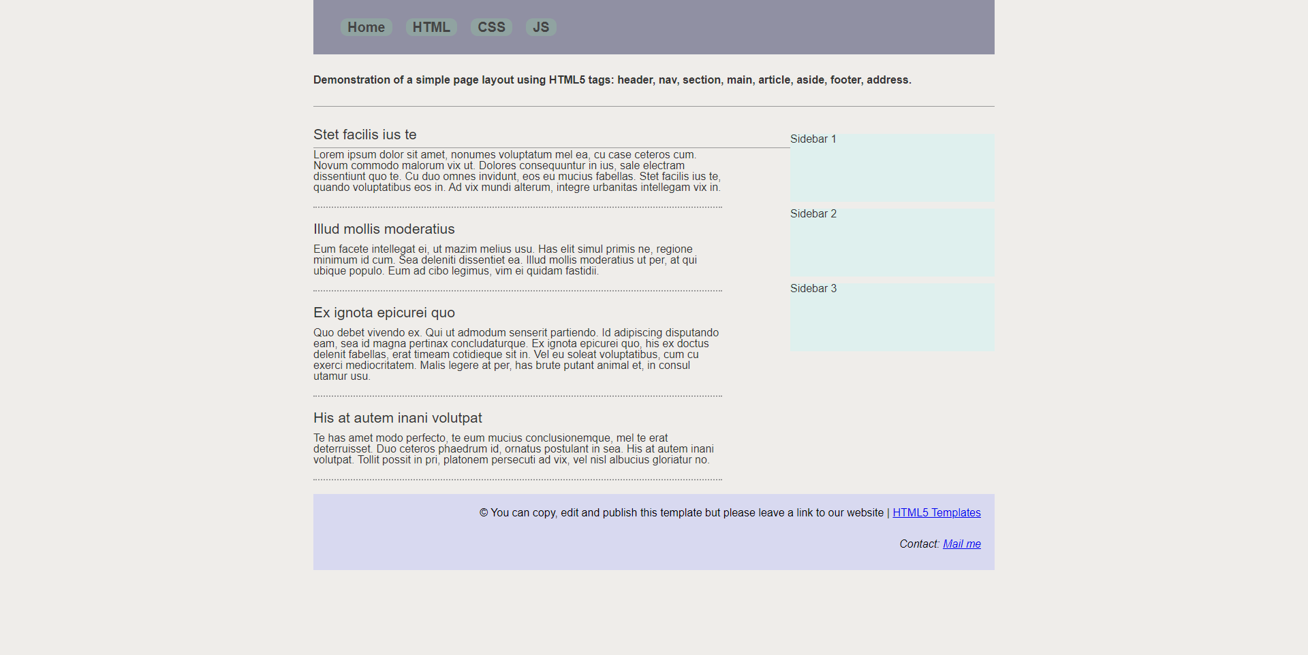
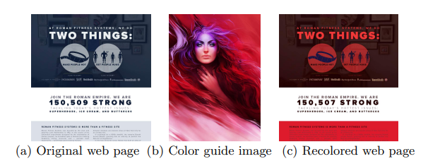
Previous reserach
Graph-Based Visual Salience [1]
Used in the implementation of the tool
Automatic Web Page Coloring [3]
Similar idea
Our tool allows for more user input
Example of salience map created with Python implementation [2]
Figure 1 in P. Volkova Et al, 2016 [3]
[1] J. Harel, C. Koch, and P. Perona, “Graph-Based Visual Salience,” 2007. Accessed: Jan. 28, 2022. [Online].
[2] J. Colella and Shreenath, “Implementation of Graph Based Visual Saliency Algorithm,” GitHub, 2019.
https://github.com/shreelock/gbvs (accessed 2022).
[3] P. Volkova, S. Abrishami, and P. Kumar, “Automatic Web Page Coloring,” Advances in Visual Computing, 2016, doi:
10.1007/978-3-319-50835-1.

Slide 3
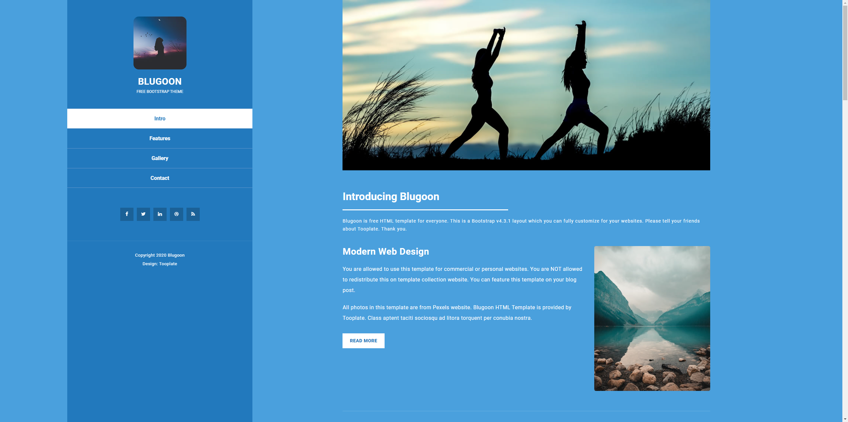

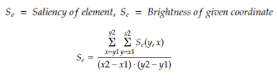
Practical Problem
GBVS
Score 46.93
Site design: https://www.tooplate.com/view/2116-blugoon (open source)

Slide 4
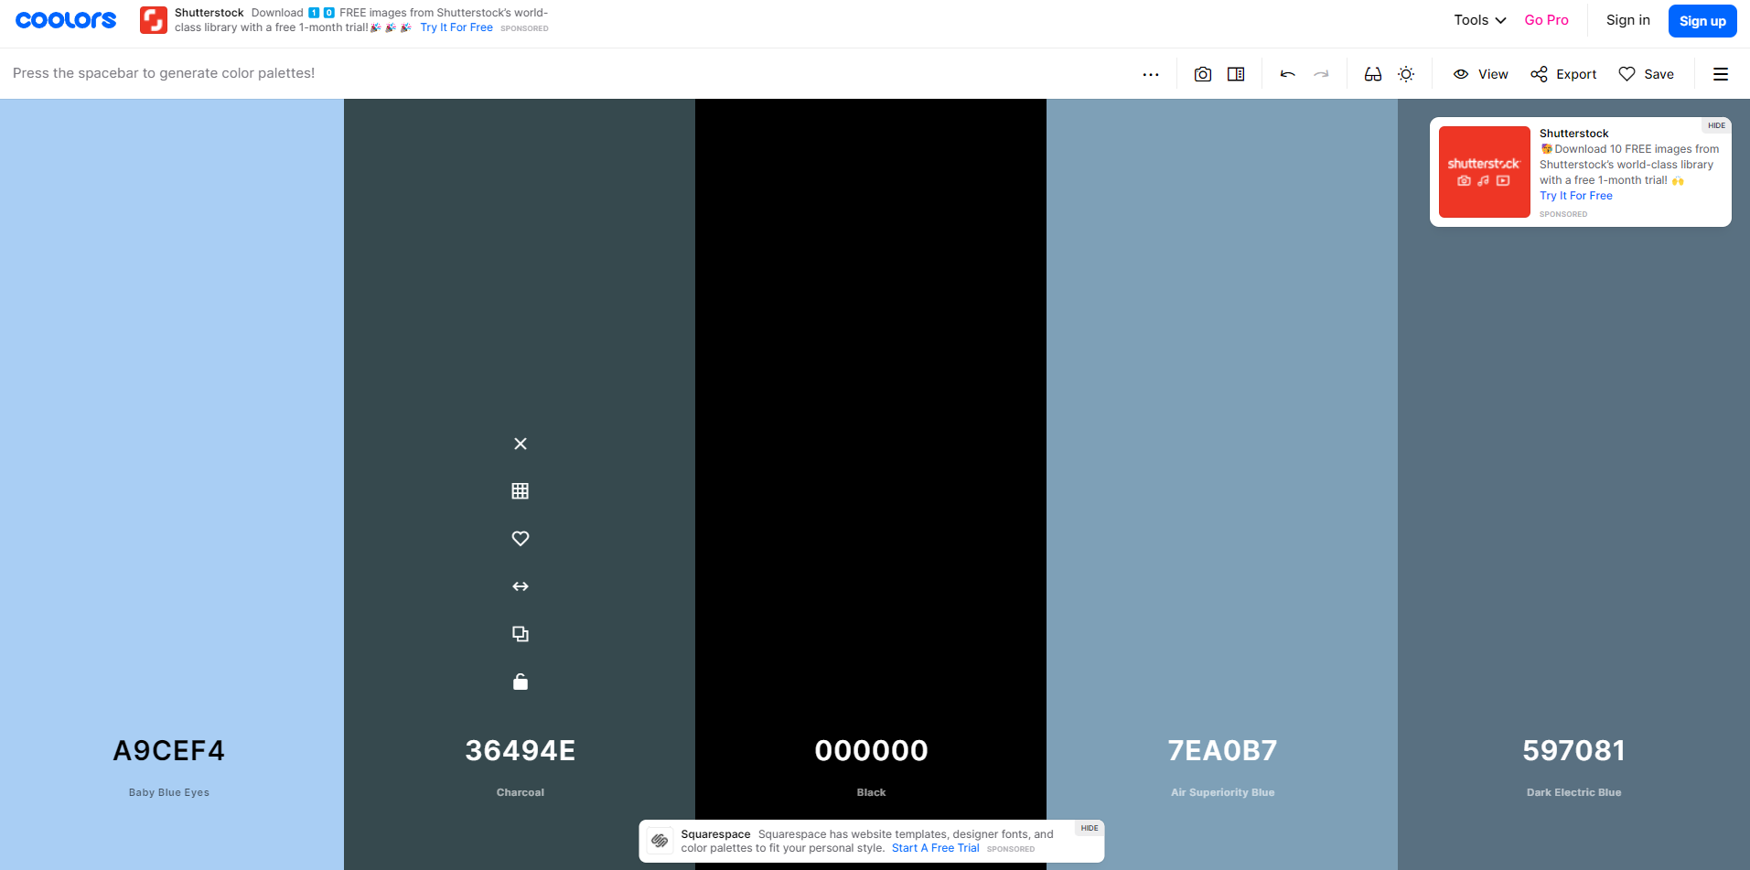
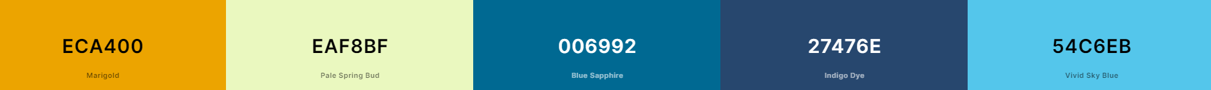

Generate Harmonious Palettes
Site: https://coolors.co/, also used https://color.adobe.com/fi/create/color-wheel
Notes:
A timesink I have had when creating website prototypes both in school and work, is the choosing and utilizing the color scheme. A practice I have developed is taking a harmonious color palette generated from a website, and utilizing that.
However, how do I know that I am utilizing this palette correctly?

Slide 5
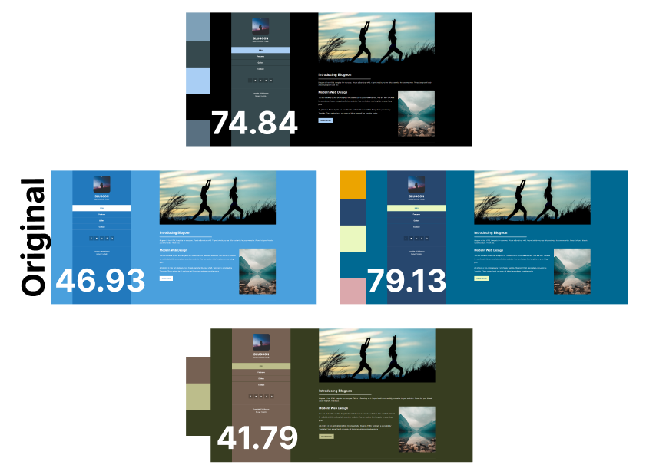
Generated Desings From Palettes
Notes:
Therefore for this course I created a tool that utilizes Graph-Based Visual Salience to choose the best color assignment for a color palette on a defined website, while prioritizing given elements.

Slide 6
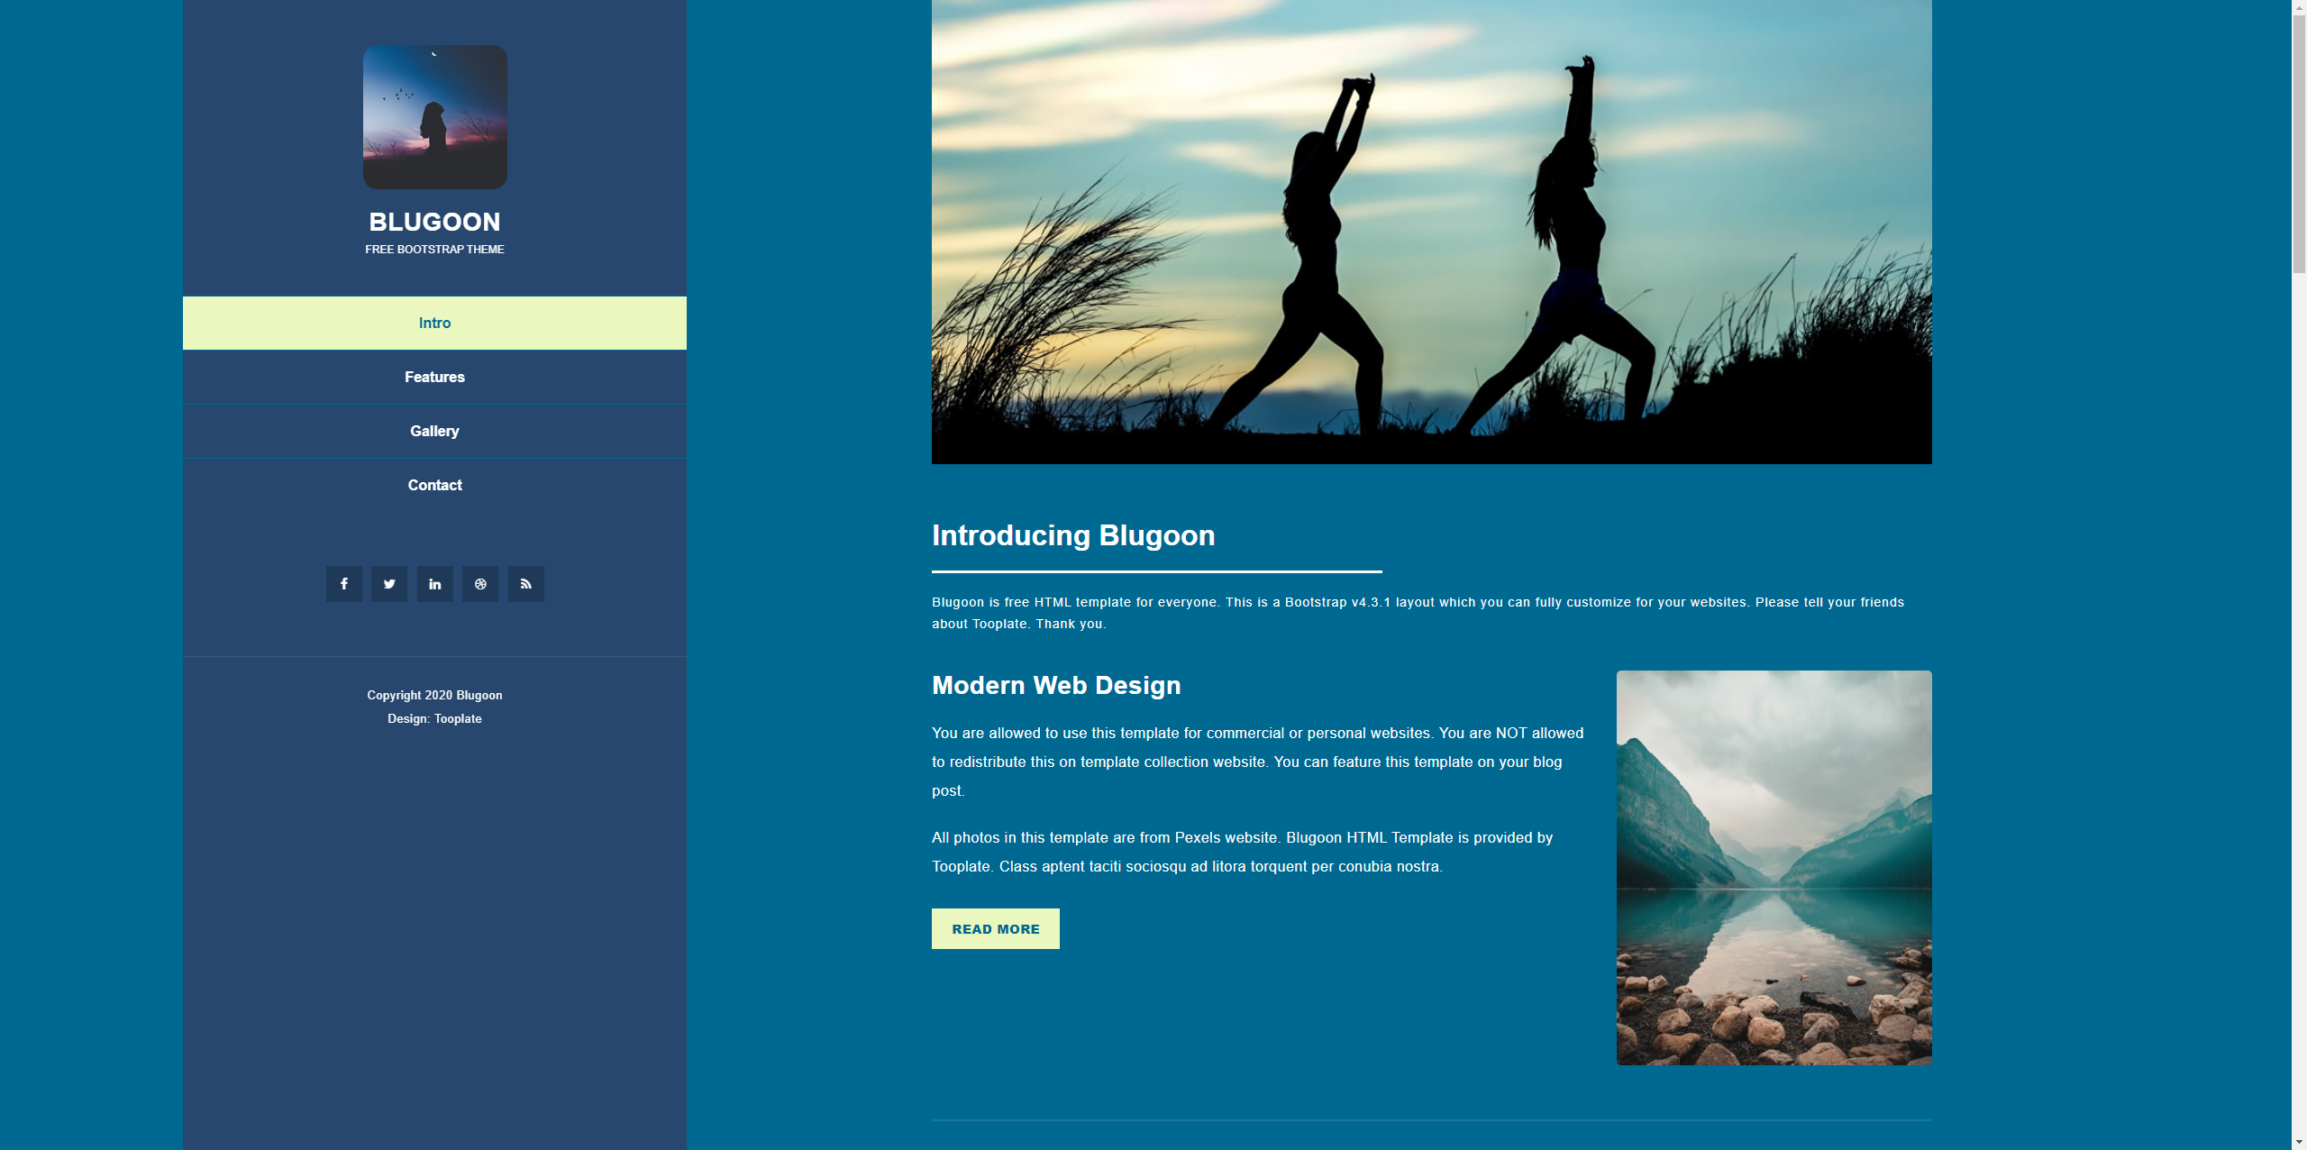

Score 46.93
Score 79.13

Slide 7
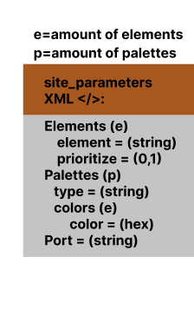
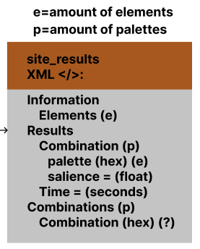

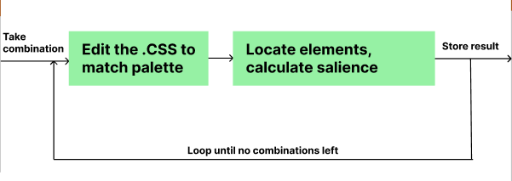
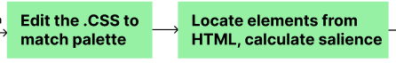

How the tool works

Slide 8
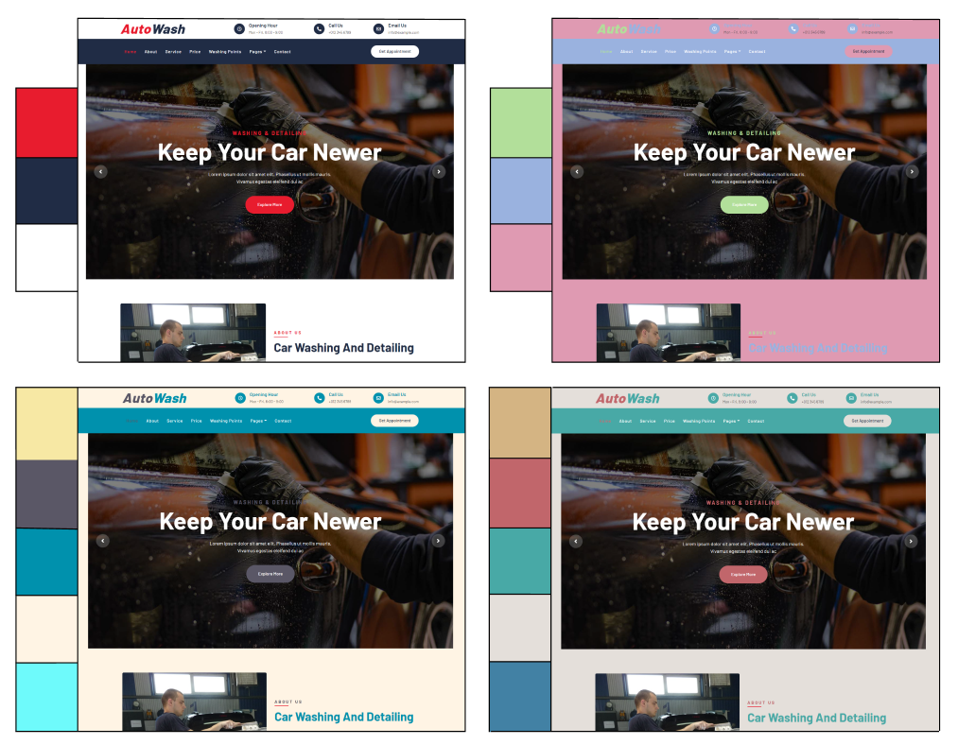
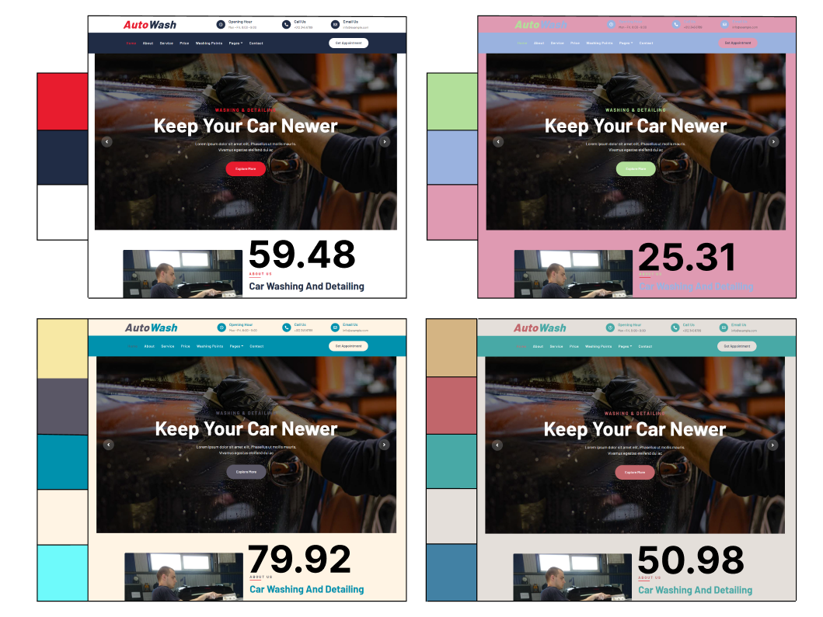
Which is the best?
Original
1
2
3
4
Site design: https://www.free-css.com/free-css-templates/page271/autowash (open source)

Slide 9


Which is better?
1
2
Score 90.95
Score 36.44
Score 92.88
Score 49.93

Slide 10
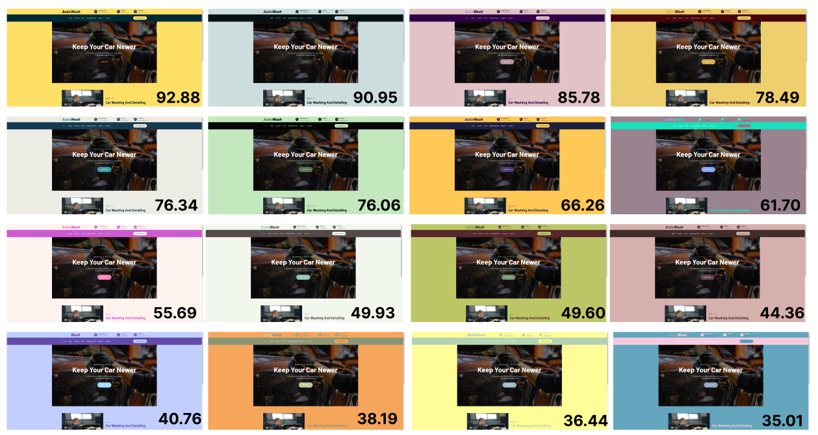

Slide 11
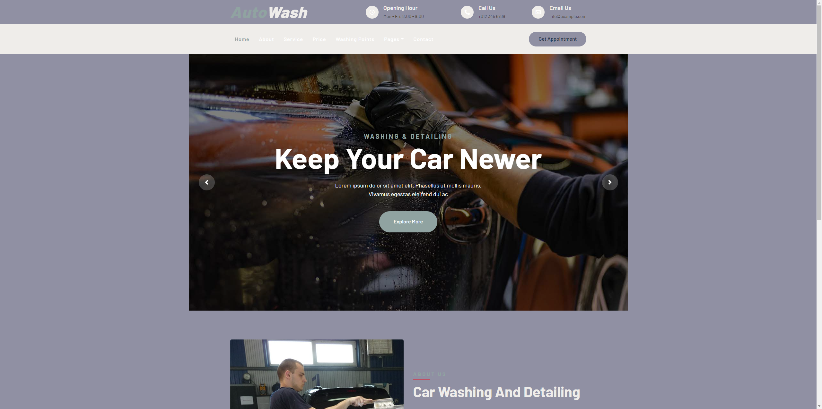
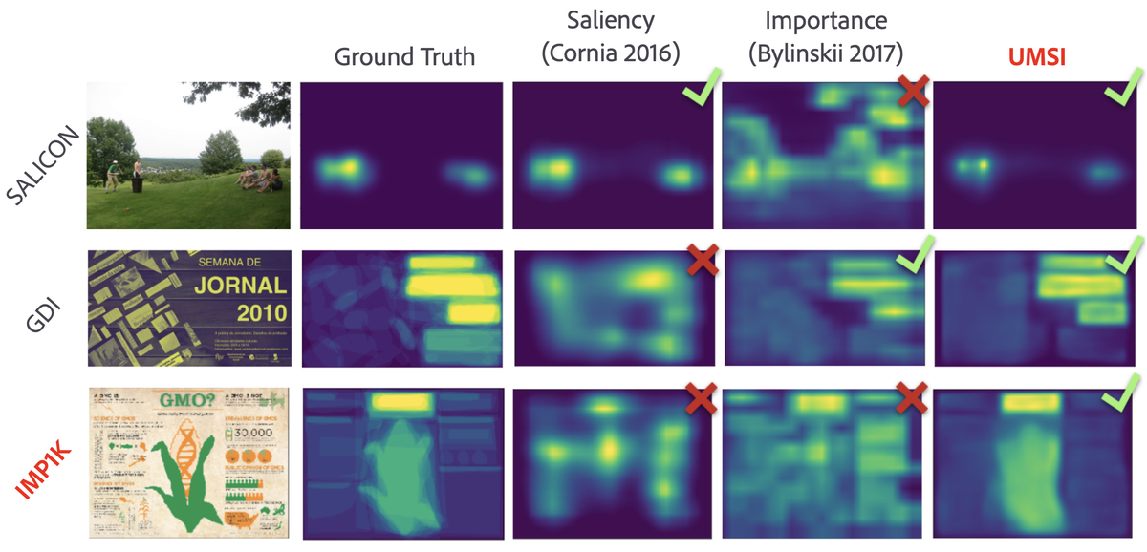
Issues and improvements
Readability
Portability
Designer evaluation
Unified Model of Saliency and Importance (UMSI) (F. Camilo et al, 2020)
Part of Figure 1 in [4]
[4] F. Camilo, C. Vincent, B. Amish, O. Peter, H. Aaron, and B. Zoya, “Predicting Visual Importance Across Graphic Design
Types,” pp. 249–260, 2020, doi: 10.1145/3379337.341582.

Slide 12
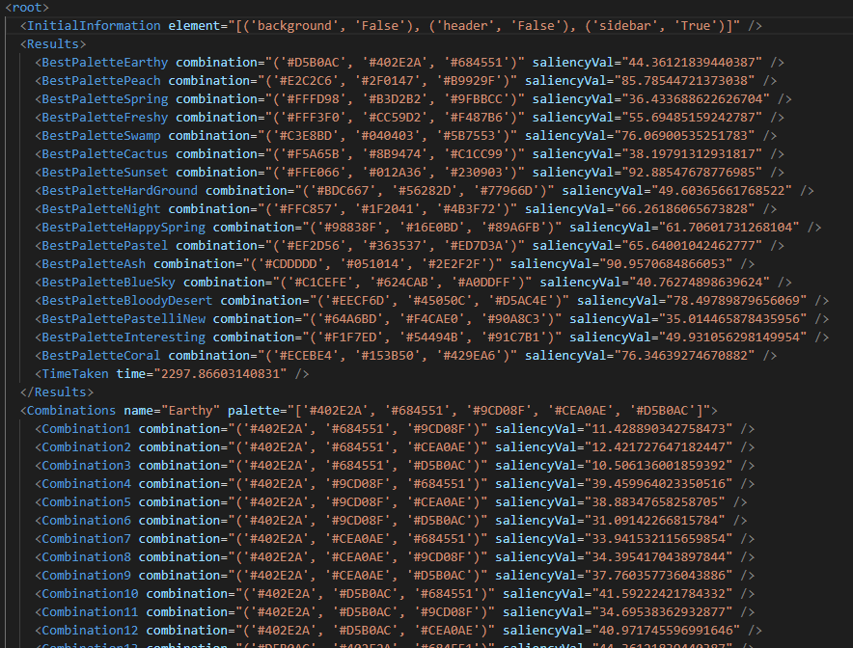
Results
Tool creates viable designs
Relatively fast (5 seconds per layout)
Easy to set up
Gives concerete values to designs
Use cases include prototypes, evaluation
Snippet of the results XML generated by the tool

Slide 13
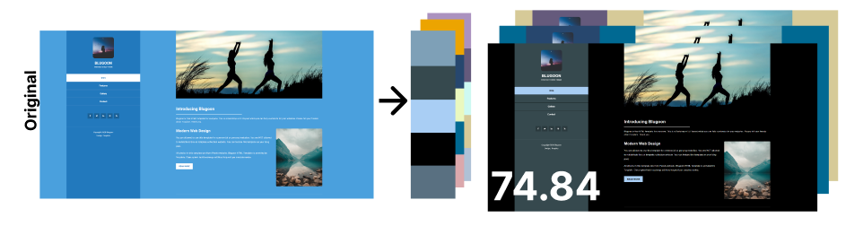
Conclusion
Goal: Create an easy way to output color assignations for a given website and palettes

